Slide 1

Cloud – fog Computing
Abhishekh kumar singh | 21it3004
Mentor: Dr. Kalka dubey

Slide 2

Agenda
PROBLEM
INTUITION
7 Step criteria
SIMULATION RESULT

Slide 3

Problem STATEMENT
Efficient controlling of tasks in Cloud-Fog
environment using Queuing model &
Data Caching.

Slide 4

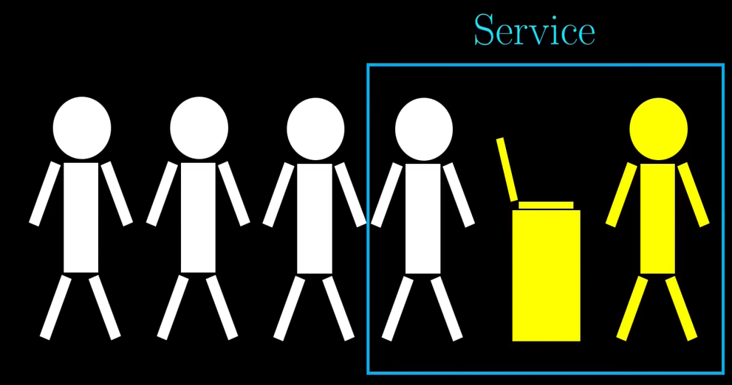
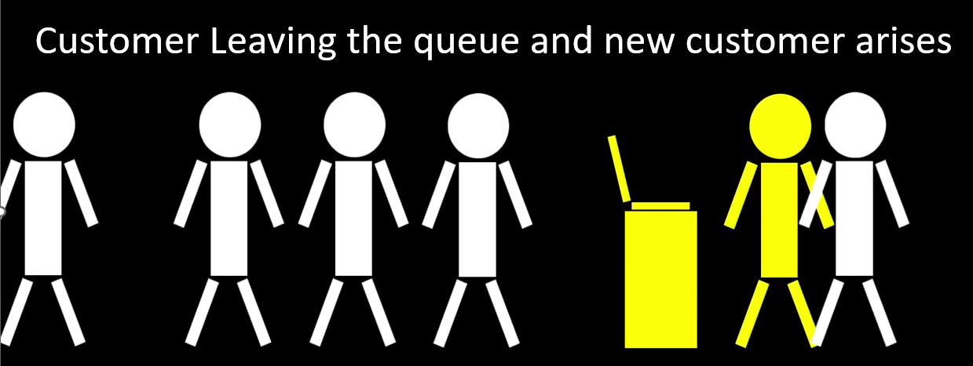
INTUITION

Slide 5
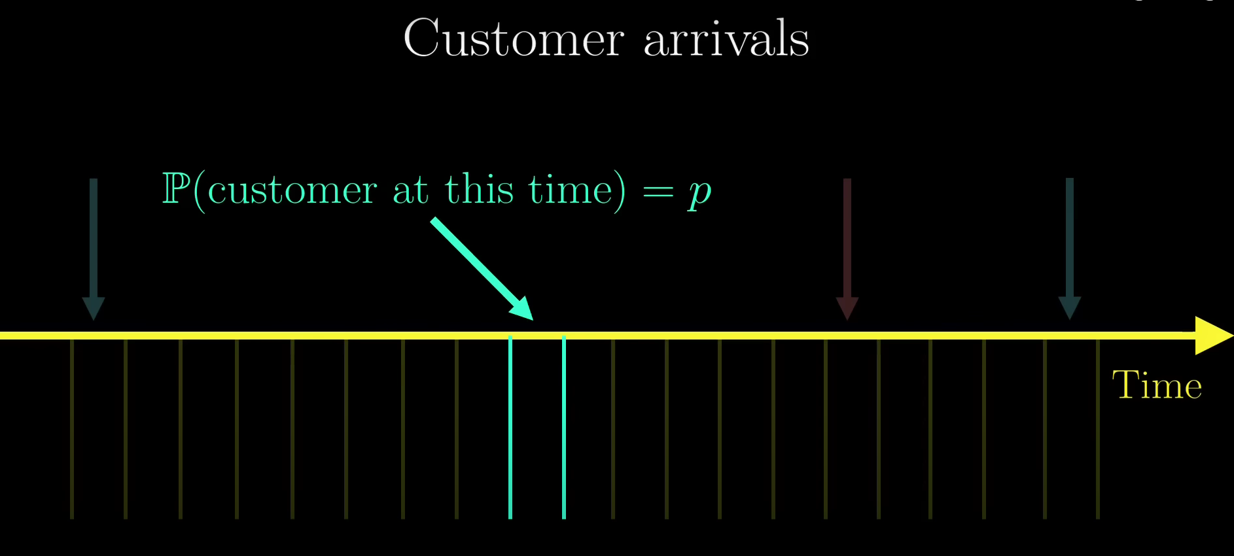
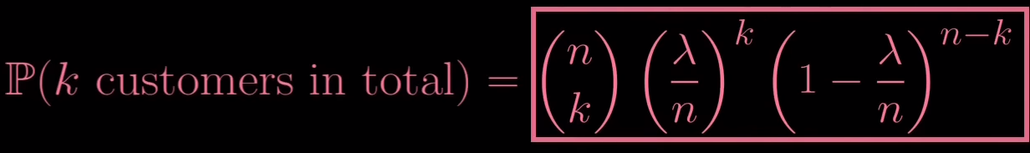
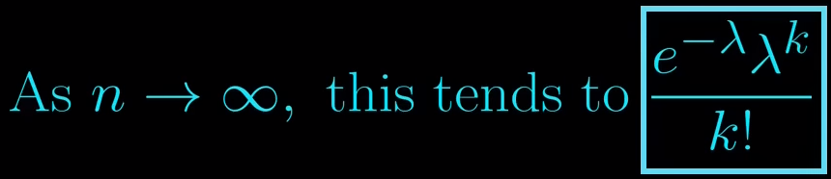
Let’s λ no of customers arrive at a queue
P(one queue block being occupied) = λ/n

Slide 6
Quarterly performance
Step 1: WSc = w1×Cost + w2×Communication Bandwidth + w3×Baud Rate + w4×Signal Level - w5× Latency
Step 2: If Weighted Score > Threshold Score
Go for Fog Processing Calculation
else : Send to Cloud
Step 3: Utilization, ρ = λ / μ
μ = Service Rate of the Fog Node
Step 4: Queue Length, L= Arrival rate * average waiting time
Step 5: Calculating Waiting Time
Using the poisson Distribution we get,
Avg waiting time= W= ρ / (μ−λ)
Step 6: Check and Decide
Average waiting time < Threshold waiting time
&&
Average Queue Length < Threshold Queue Length
Add task to Queue
Step 7: Dynamic Adjustment

Slide 7
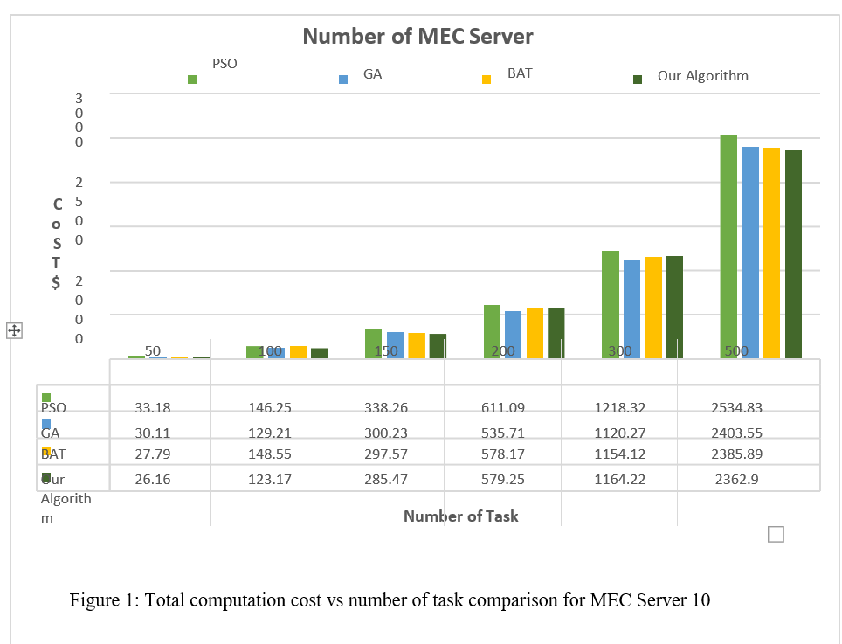
Simulation result

Slide 8
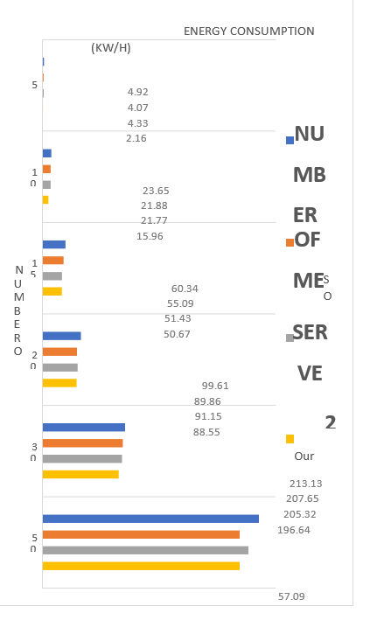
Simulation result

Slide 9


Thank you

